Slide 1

An Analysis of In-Demand Tech Skills
By Syed Ayaan Danish

Slide 2



OUTLINE
Executive Summary
Introduction
Methodology
Results
Visualization – Charts
Dashboard
Discussion
Findings & Implications
Conclusion
Appendix

Slide 3

EXECUTIVE SUMMARY
Technology Trends – Growing adoption of cloud platforms, modern databases, and TypeScript.
Database Insights – PostgreSQL leads in usage and demand; Redis and SQLite are gaining traction.
Programming Shifts – TypeScript's popularity is rising, with Next.js emerging as a preferred framework.
Skill Demand – Companies seek expertise in cloud computing, modern frameworks, and scalable databases.
Industry Implications – Upskilling in high-demand technologies is crucial for professionals and businesses.

Slide 4

INTRODUCTION
This report aims to summarize the most in-demand tech skills
Looked at the current landscape as well as future trends.
Categories of skills covered include:
Programming Languages
Databases
Web Development Frameworks
Tech Platforms
Report is targeted towards aspiring tech professionals, as well as job seekers.
Report can serve to guide individuals on what tech skills to acquire or sharpen, to improve their job prospects.

Slide 5

METHODOLOGY
Analysis data was sourced from:
Stack Overflow Developer Survey 2024
Job Postings
Developer training portals
Data collection methods used:
Web Scraping
Accessing Public APIs
Downloading publicly published survey data
Data wrangling steps:
Identifying and removing duplicate records
Identifying and imputing missing values
Normalizing the data
Performing exploratory data analysis
Handling outliers
Analyzing correlation
With the data prepared for analysis, it was then visualized with a variety of methods.
Dashboards were created to summarize the data at a glance.

Slide 6
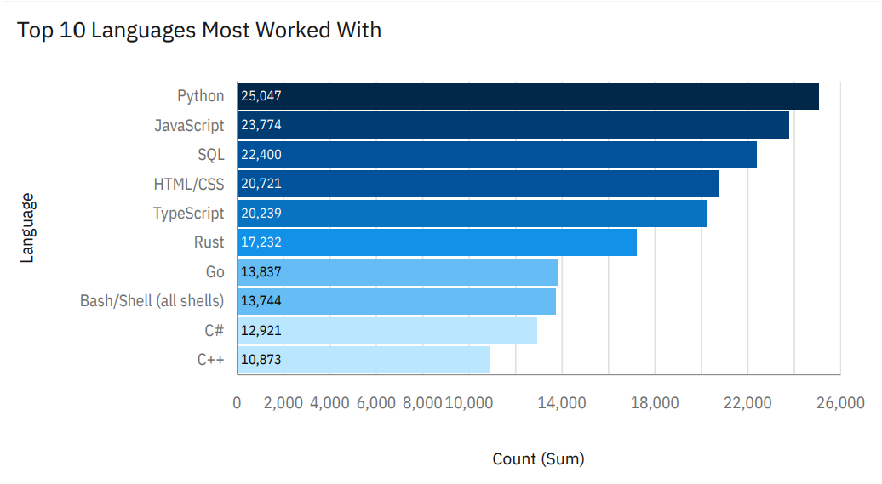
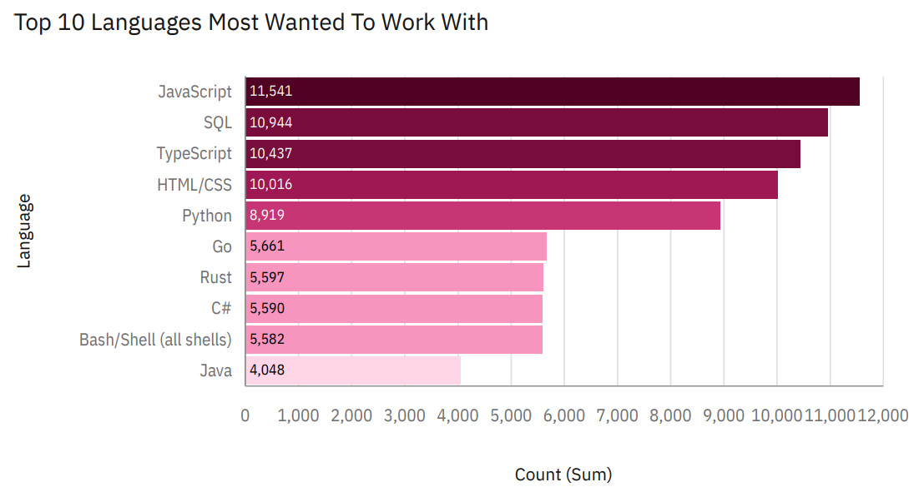
PROGRAMMING LANGUAGE TRENDS
Current Year
Next Year

Slide 7
PROGRAMMING LANGUAGE TRENDS - FINDINGS & IMPLICATIONS
Findings
Python is the most used currently, but less desired in the future.
JavaScript remains highly relevant across the board.
SQL and TypeScript are also consistently strong.
Implications
Python’s demand is set to plateau in the future.
JavaScript is set to overtake Python in the future.
SQL remains essential in the future as a databasing tool.

Slide 8
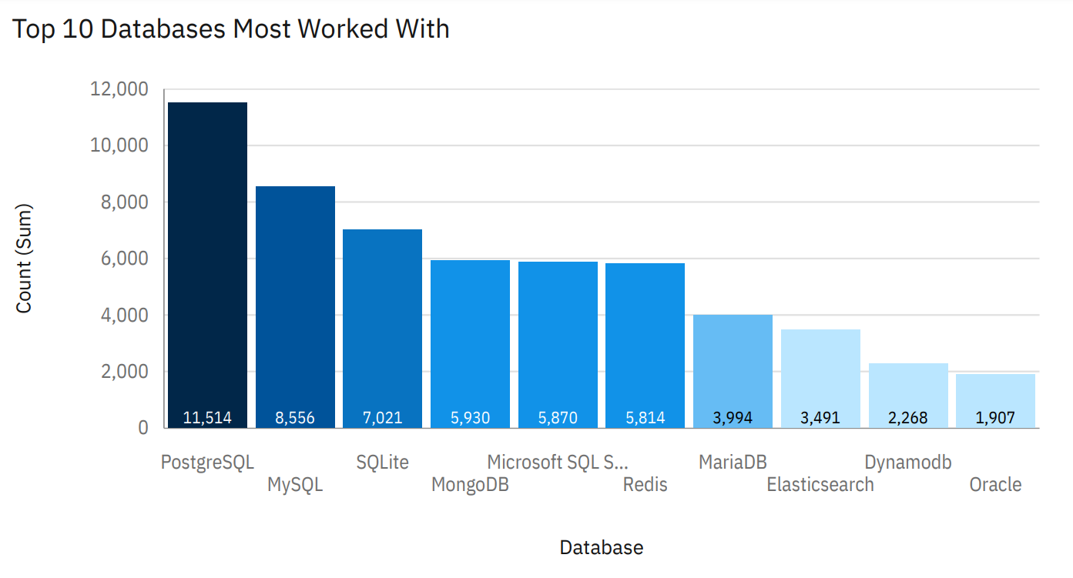
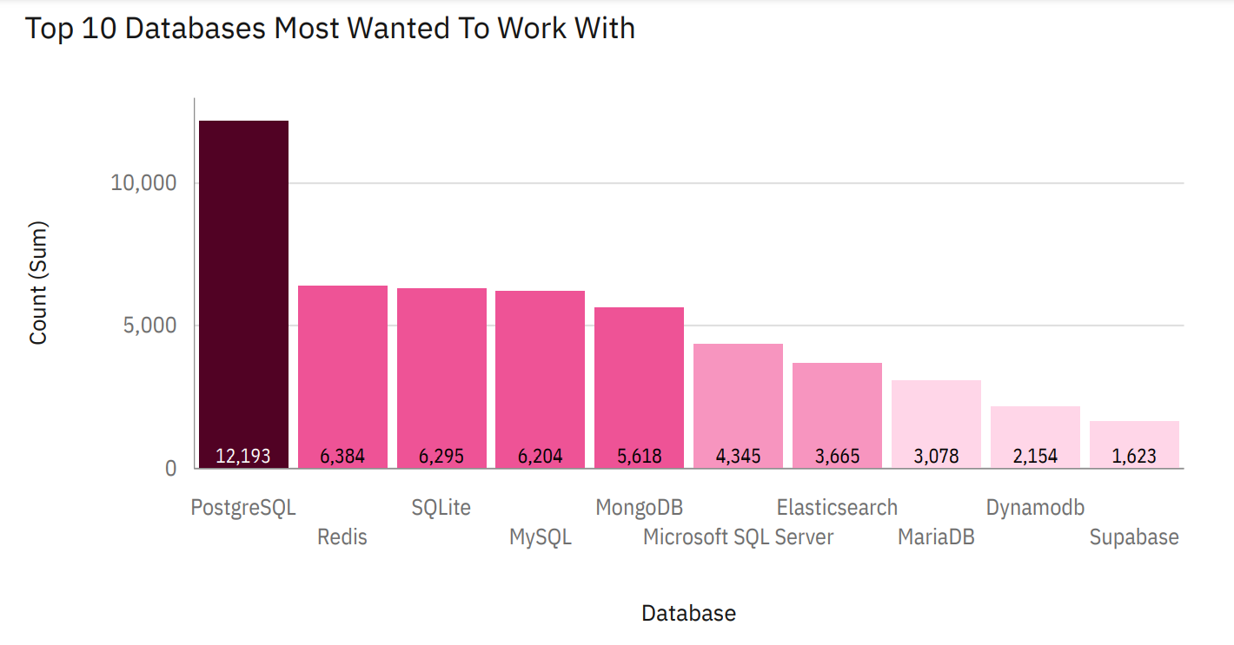
DATABASE TRENDS
Current Year
Next Year

Slide 9
DATABASE TRENDS - FINDINGS & IMPLICATIONS
Findings
PostgreSQL is the most used now and most desired in the future.
MySQL and SQLite are consistently popular.
Redis has high future demand despite low current use.
Implications
PostgreSQL's dominance will likely grow.
MySQL and SQLite remain reliable choices.
Redis adoption may increase significantly.

Slide 10

DASHBOARD
Dashboards created using IBM Cognos Analytics
Includes:
Current Tech Skill Demands
Future Tech Skill Trends
Survey Respondent Demographics

Slide 11
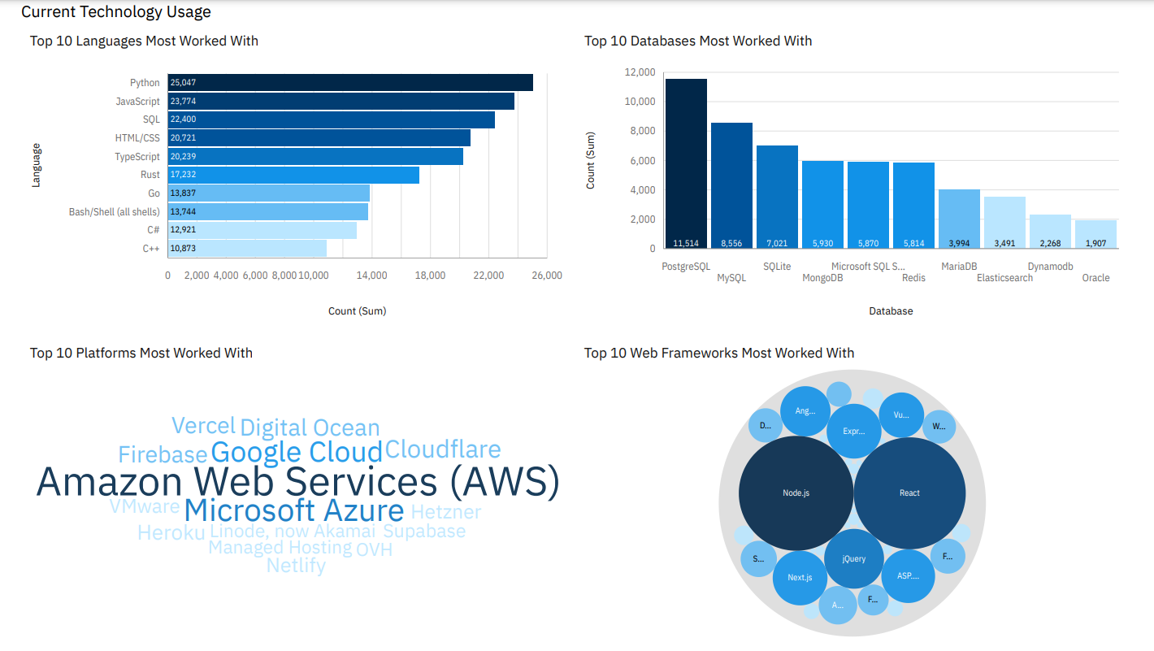
DASHBOARD TAB 1

Slide 12
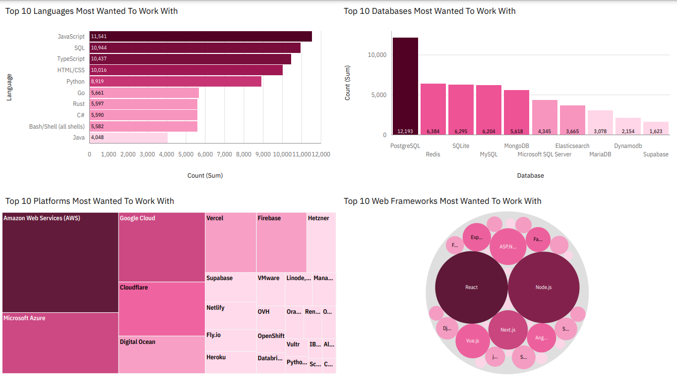
DASHBOARD TAB 2

Slide 13
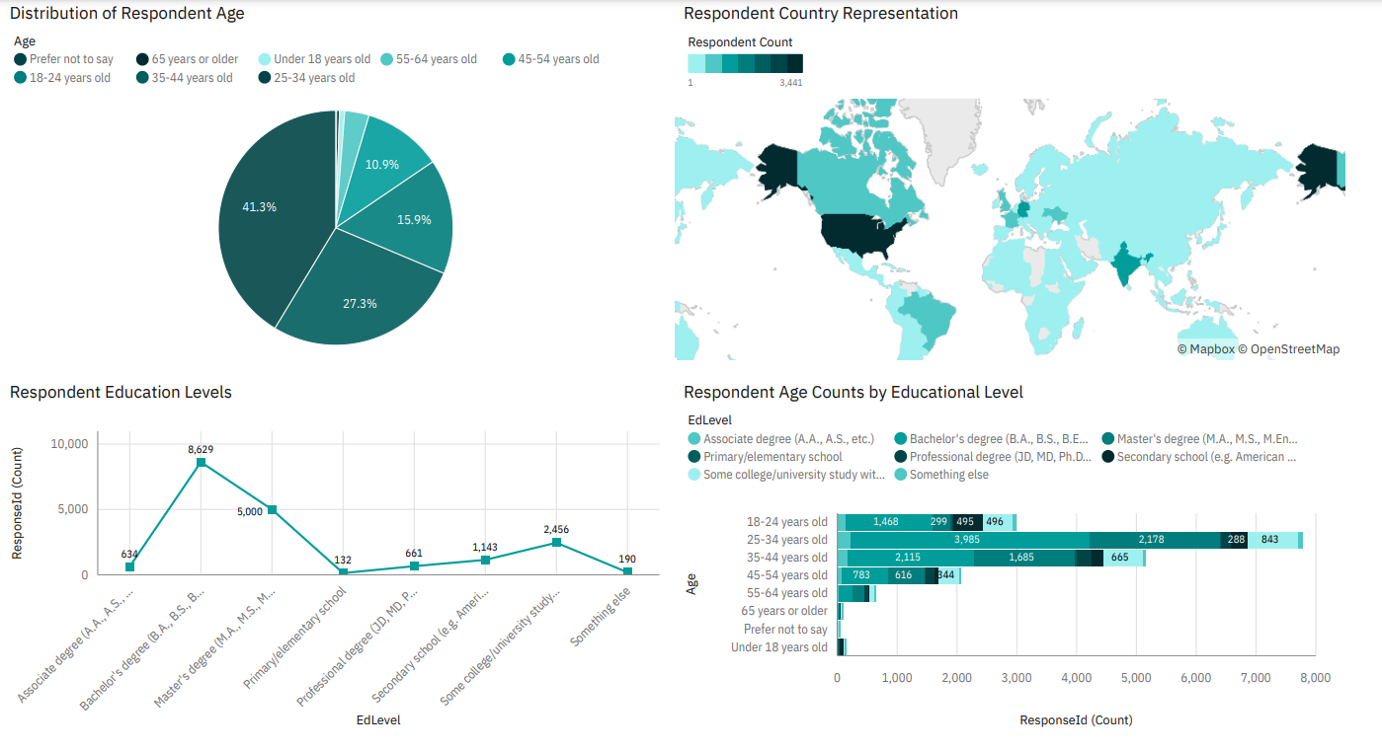
DASHBOARD TAB 3

Slide 14
DISCUSSION – CURRENT TECH USAGE
Programming Languages: Python, JavaScript, and SQL are the most used languages.
Web Frameworks: React and Node.js are the most frequently worked-with frameworks.
Cloud Platforms: AWS, Azure, and Google Cloud dominate the industry.
Databases: PostgreSQL and MySQL are the most popular databases.

Slide 15
DISCUSSION – FUTURE TECH TRENDS
Programming Languages: JavaScript, SQL, and TypeScript are the top languages developers want to work with.
Web Frameworks in Demand: React, Next.js, and Vue.js are highly desired.
Cloud Platforms of Interest: AWS, Azure, and Google Cloud remain the top choices.
Databases of Interest: PostgreSQL is the most wanted database, followed by Redis and SQLite.

Slide 16
DISCUSSION – SURVEY DEMOGRAPHICS
Age Distribution: Most respondents fall between the 25-34 age range.
Education Levels: Most respondents hold a bachelor's degree, followed by a master’s degree.
Geographical Distribution: The respondent base is globally diverse, with a significant number from North America and Europe.

Slide 17
OVERALL FINDINGS & IMPLICATIONS
Findings
PostgreSQL Leads – Most used and most desired database.
Cloud & Web Growth – AWS, Azure, React, and Next.js dominate.
Shifting Skill Demand – TypeScript, Redis, and modern frameworks gain traction.
Implications
Job Market – PostgreSQL, React, and cloud skills are valuable.
Upskilling – TypeScript, Redis, and Next.js boost career prospects.
Tech Strategy – Companies should invest in cloud and modern frameworks

Slide 18

CONCLUSION
Adaptability is key – Professionals should upskill in trending technologies like cloud and modern frameworks.
Strategic hiring – Companies must prioritize expertise in PostgreSQL, TypeScript, and cloud platforms.
Market shifts – The demand for emerging tools like Next.js and Redis signals evolving industry needs.
Future readiness – Staying ahead requires continuous learning and integration of high-demand technologies

Slide 19
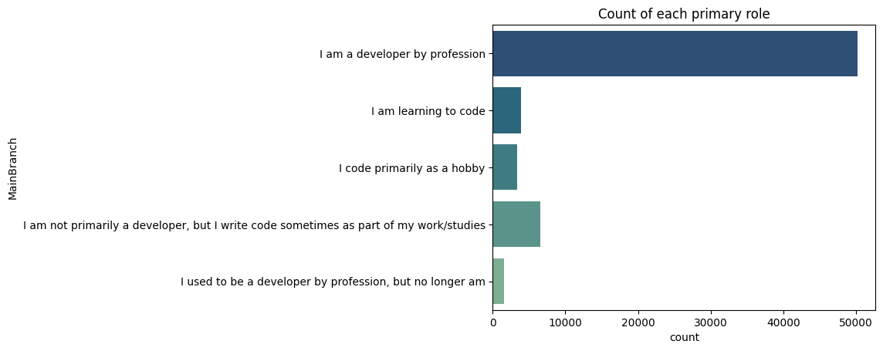

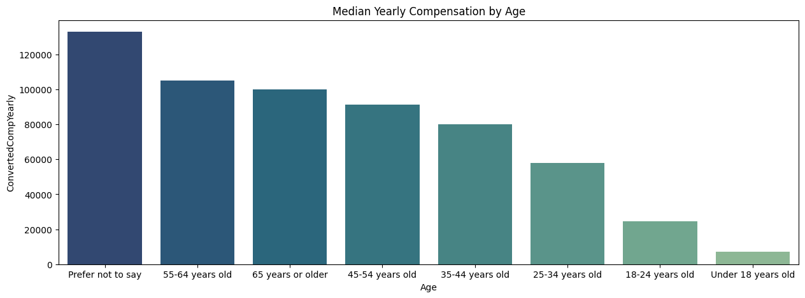
APPENDIX

Slide 20
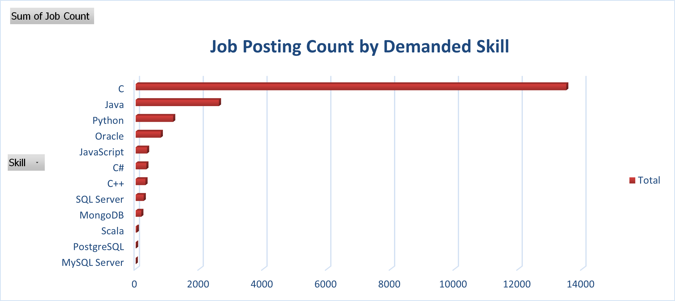
JOB POSTINGS

Slide 21
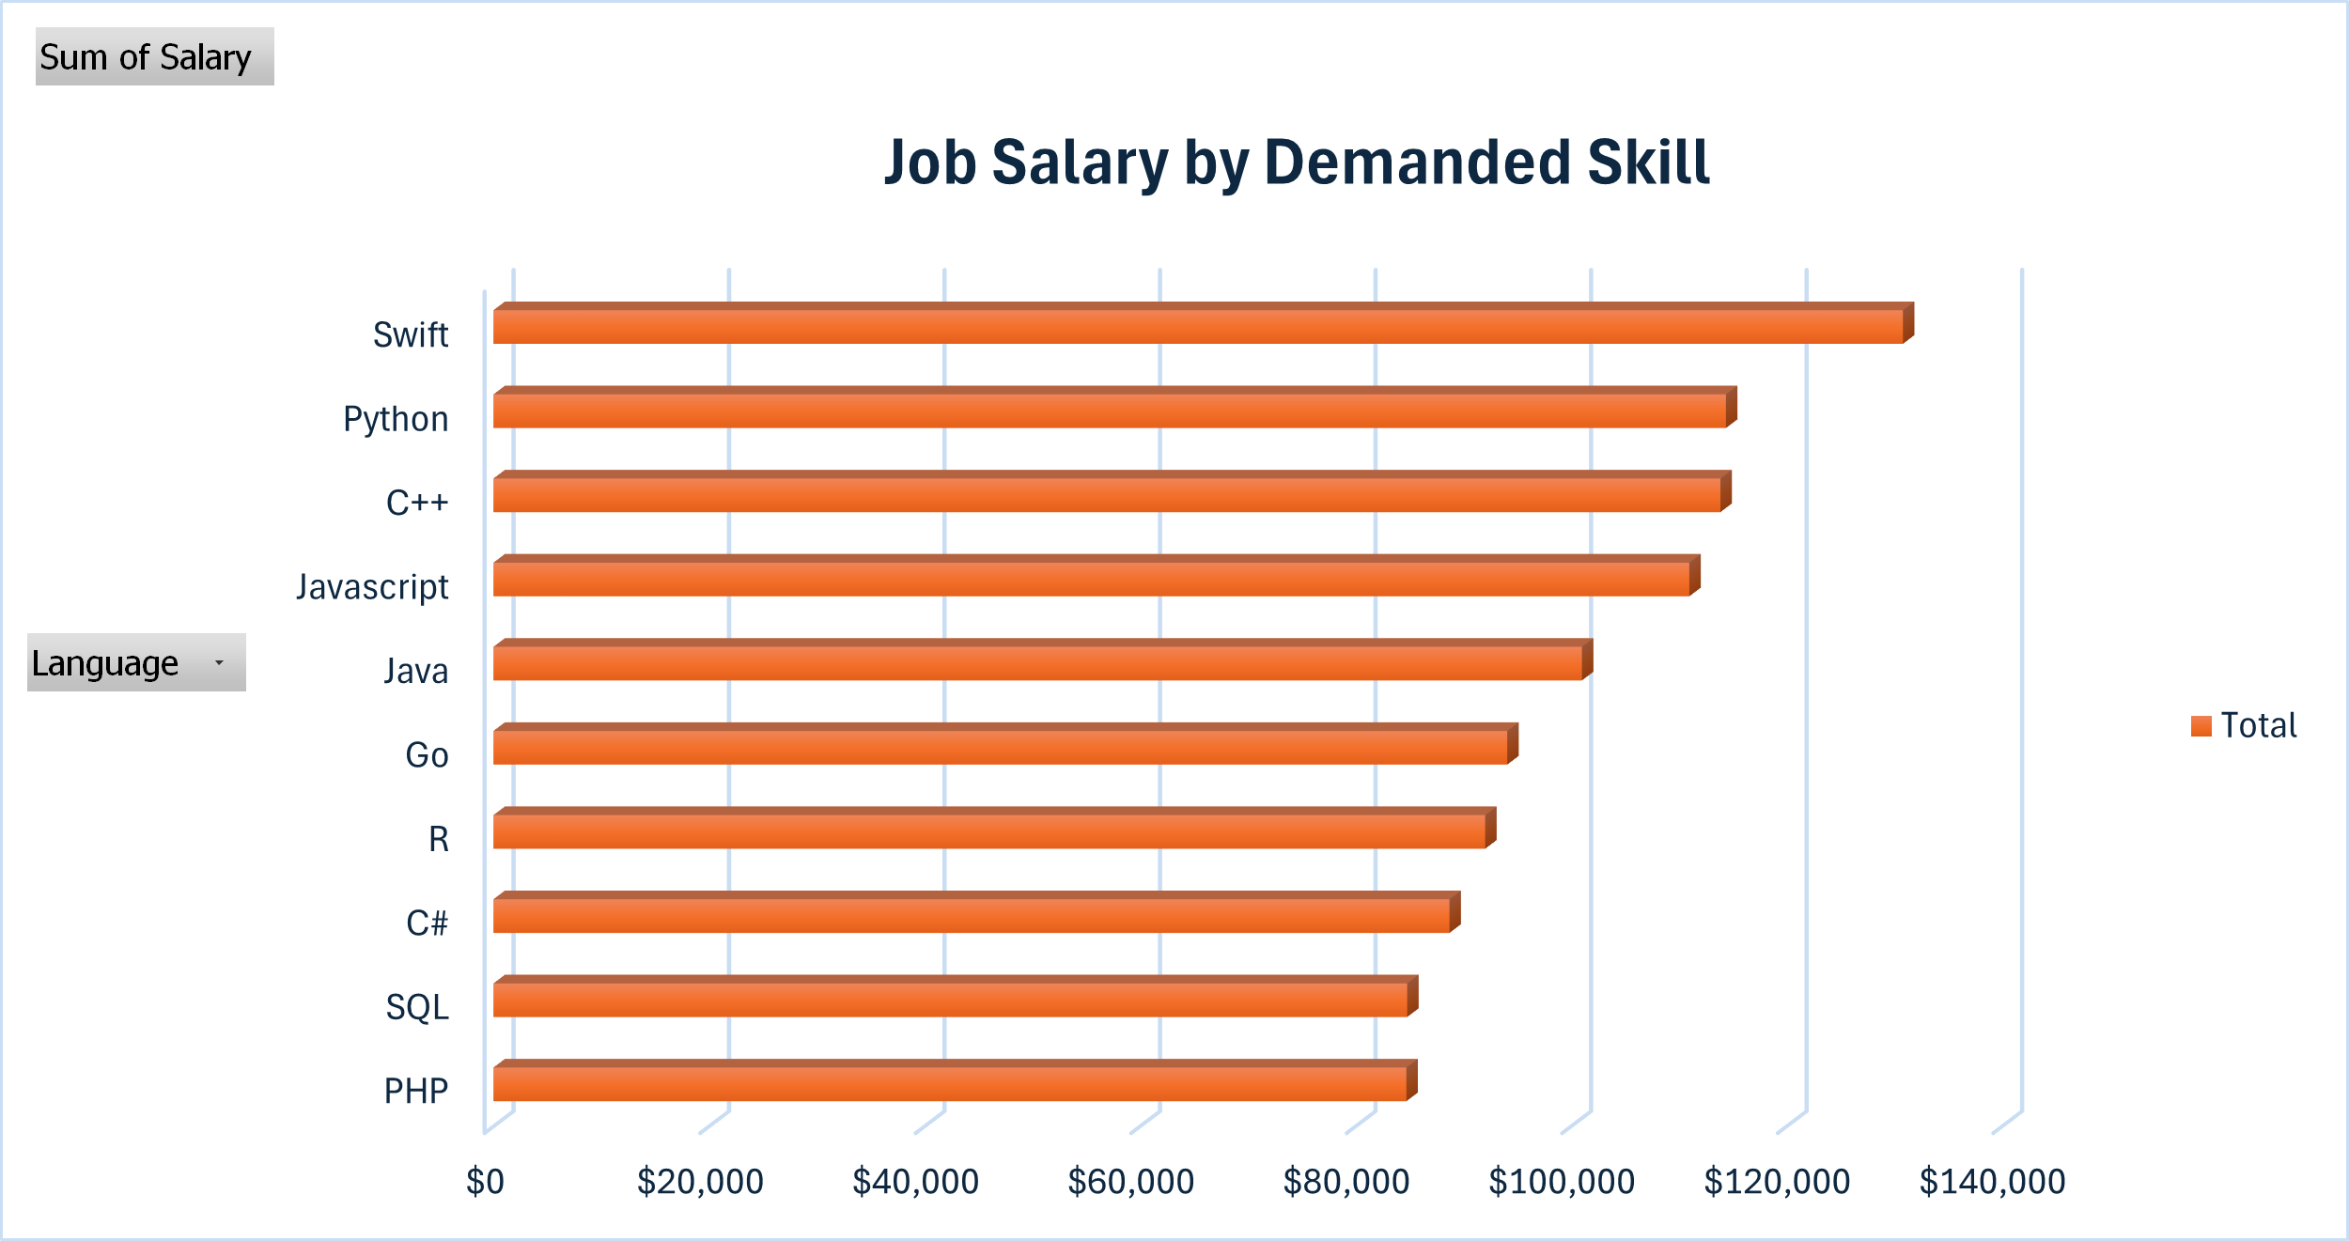
POPULAR LANGUAGES

